Slide 1
Heuristic Optimization Methods
Genetic Algorithms

Slide 2
Agenda
Short overview of Local Search and Local Search-based Metaheuristics
Introduction to Genetic Algorithms

Slide 3
Local Search (1)
Basic Idea: Improve the current solution
Start with some solution
Find a set of solutions (called neighbors) that are ”close” to the current solution
If one of these neighbors are better than the current solution, move to that solution
Repeat until no improvements can be made

Slide 4
Local Search (2)
Variations
  Best Improvement (always select the best neighbor)
  First Improvement (select the first improving neighbor)
  Random Descent (select neighbors at random)
  Random Walk (move to neighbors at random)
Problem: Gets stuck in a local optimum
  (except Random Walk, which isn’t a good method anyway)

Slide 5
Local Search Based Metaheuristics (1)
Main goal
  To avoid getting stuck in local optima
Additional goals
  Explore a larger part of the search space
  Attempt to find the global (not just a local) optimum
  Give a reasonable alternative to exact methods (especially for large/hard problem instances, and where the solution time is important)

Slide 6
Local Search Based Metaheuristics (2)
The different methods employ very different techniques in order to escape local optima
  Simulated Annealing relies on controlled random movement
  Tabu Search relies on memory structures, recording enough information to prevent looping between solutions

Slide 7
Local Search Based Metaheuristics (3)
The different methods employ very different techniques in order explore a larger part of the search space
  Simulated Annealing relies on controlled random movement
  Tabu Search relies on memory structures, recording enough information to guide the search to different areas of the search space (e.g., frequency based diversification)

Slide 8
Local Search Based Metaheuristics (4)
Which method is better?
Depends on your needs
  SA is easier to implement?
  SA is easier to use/understand?
  TS is more flexible and robust?
  TS requires a better understanding of the problem?
  TS requires more ”tuning”?
  TS produces better overall results?

Slide 9
Genetic Algorithms
We have now studied many Metaheuristics based on the idea of a Local Search
It is time to look at methods that are based on different mechanisms
The first such method will be the Genetic Algorithm

Slide 10
The Genetic Algorithm
Directed search algorithms based on the mechanics of biological evolution
Developed by John Holland, University of Michigan (1970’s)
  To understand the adaptive processes of natural systems
  To design artificial systems software that retains the robustness of natural systems

Slide 11
Genetic Algorithms
Provide efficient, effective techniques for optimization and machine learning applications
Widely-used today in business, scientific and engineering circles

Slide 12
Genetic Algorithms (GA)
Function Optimization
AI (Games,Pattern recognition ...)
OR after a while
Basic idea:
  intelligent exploration of the search space based on random search
  analogies from biology

Slide 13
GA - Analogies with biology
Representation of complex objects
by a vector of simple components
Chromosomes
Selective breeding
Darwinistic evolution
Classical GA: Binary encoding

Slide 14
Components of a GA
A problem to solve, and ...
Encoding technique (gene, chromosome)
Initialization procedure (creation)
Evaluation function (environment)
Selection of parents (reproduction)
Genetic operators (mutation, recombination)
Parameter settings (practice and art)

Slide 15
Classical GA:
Binary Chromosomes
Chromosome, component vector, vector, string, solution,
individual x=(x₁, ... , x₇)
Gene, Component, Variable, x₃
x₃∈{0,1}
Locus, position
Allele, value
Alleles, domain

Slide 16
Genotype, Phenotype, Population
Genotype
  chromosome
  Coding of chromosomes
  coded string, set of coded strings
Phenotype
  The physical expression
  Properties of a set of solutions
Population – a set of solutions

Slide 17
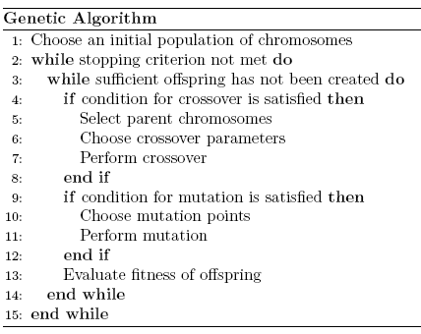

Slide 18
The GA Cycle of Reproduction
children
reproduction
modification
modified
children
parents
population
evaluation
evaluated children
deleted
members
discard

Slide 19
Evaluation
The evaluator decodes a chromosome and assigns it a fitness measure
The evaluator is the only link between a classical GA and the problem it is solving
modified
children
evaluated
children
evaluation

Slide 20
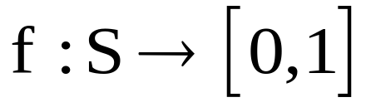
Evaluation of Individuals
Adaptability – ”fitness”
Relates to the objective function value for a DOP
Fitness is maximized
Used in selection (”Survival of the fittest”)
Often normalized

Slide 21
Genetic Operators
Manipulates chromosomes/solutions
Mutation: Unary operator
  Inversions
Crossover: Binary operator

Slide 22
GA - Evolution
N generations of populations
For every step in the evolution
  Selection of individuals for genetic operations
  Creation of new individuals (reproduction)
  Mutation
  Selection of individuals to survive
Fixed population size M

Slide 23
Chromosome Modification
Modifications are stochastically triggered
Operator types are:
  Mutation
  Crossover (recombination)
children
modification
modified children

Slide 24
GA - Mutation

Slide 25
Mutation: Local Modification
Before: (1 0 1 1 0 1 1 0)
After: (1 0 1 0 0 1 1 0)
Before: (1.38 -69.4 326.44 0.1)
After: (1.38 -67.5 326.44 0.1)
Causes movement in the search space
(local or global)
Restores lost information to the population

Slide 26
Crossover: Recombination
P1 (0 1 1 0 1 0 0 0) (0 1 1 1 1 0 1 0) C1
P2 (1 1 0 1 1 0 1 0) (1 1 0 0 1 0 0 0) C2
Crossover is a critical feature of genetic
algorithms:
  It greatly accelerates search early in evolution of a population
  It leads to effective combination of schemata (subsolutions on different chromosomes)

Slide 27
Reproduction
children
reproduction
parents
population
Parents are selected at random with selection chances biased in relation to chromosome evaluations

Slide 28
GA - Evolution
Generation X
Generation X+1
Mutation
Selection
M=10
Cross-over

Slide 29
Population
Chromosomes could be:
  Bit strings (0101 ... 1100)
  Real numbers (43.2 -33.1 ... 0.0 89.2)
  Permutations of element (E11 E3 E7 ... E1 E15)
  Lists of rules (R1 R2 R3 ... R22 R23)
  Program elements (genetic programming)
  ... any data structure ...
population

Slide 30
Classical GA: Binary chromosomes
Functional optimization
  Chromosome corresponds to a binary encoding of a
  real number - min/max of an arbitrary function
COP, TSP as an example
  Binary encoding of a solution
  Often better with a more direct representation
  (e.g. sequence representation)

Slide 31
GA - Classical Crossover (1-point)
One parent is selected based on fitness
The other parent is selected randomly
Random choice of cross-over point
Parent 1
Parent 2
Cross-over point
Child 1
Child 2

Slide 32
GA – Classical Crossover
Arbitrary (or worst) individual in the population is changed with one of the two offspring (e.g. the best)
Reproduce as long as you want
Can be regarded as a sequence of almost equal populations
Alternatively:
  One parent selected according to fitness
  Crossover until (at least) M offspring are created
  The new population consists of the offspring
Lots of other possibilities ...
Basic GA with classical crossover and mutation often works well

Slide 33
GA – Standard Reproduction Plan
Fixed population size
Standard cross-over
  One parent selected according to fitness
  The other selected randomly
  Random cross-over point
  A random individual is exchanged with one of the offspring
Mutation
  A certain probability that an individual mutate
  Random choice of which gene to mutate
  Standard: mutation of offspring

Slide 34
Deletion
Generational GA:
entire populations replaced each iteration
Steady-state GA:
a few members replaced each generation
population
discarded members
discard

Slide 35
An Abstract Example
Distribution of Individuals in Generation 0
Distribution of Individuals in Generation N

Slide 36
A Simple Example
The Traveling Salesman Problem:
Find a tour of a given set of cities so that
  each city is visited only once
  the total distance traveled is minimized

Slide 37
Representation
Representation is an ordered list of city
numbers known as an order-based GA.
1) London 3) Dunedin 5) Beijing 7) Tokyo
2) Venice 4) Singapore 6) Phoenix 8) Victoria
City List 1 (3 5 7 2 1 6 4 8)
City List 2 (2 5 7 6 8 1 3 4)

Slide 38
Crossover
Crossover combines inversion and
recombination:
* *
Parent1 (3 5 7 2 1 6 4 8)
Parent2 (2 5 7 6 8 1 3 4)
Child (5 8 7 2 1 6 3 4)
This operator is called order-based crossover.

Slide 39
Mutation
Mutation involves reordering of the list:
* *
Before: (5 8 7 2 1 6 3 4)
After: (5 8 6 2 1 7 3 4)

Slide 40
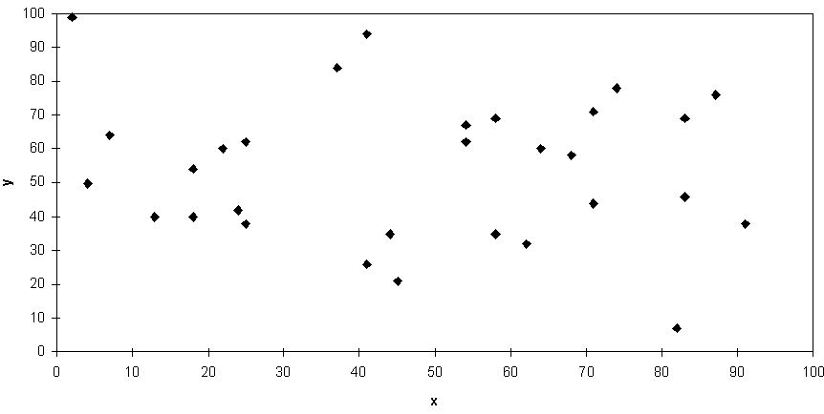
TSP Example: 30 Cities

Slide 41
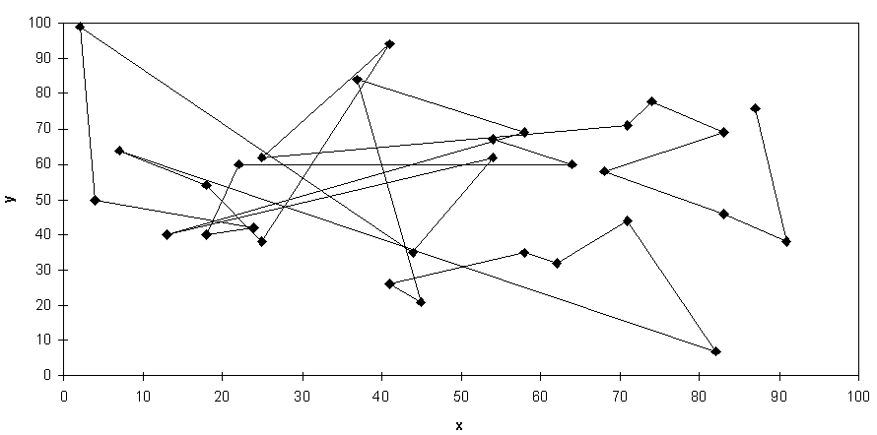
Solution _{i} (Distance = 941)

Slide 42
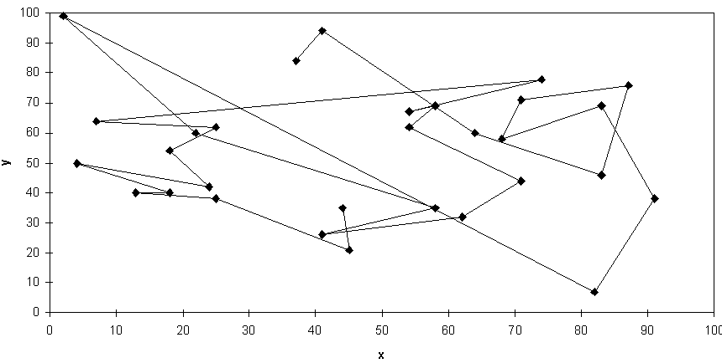
Solution _{j} (Distance = 800)

Slide 43
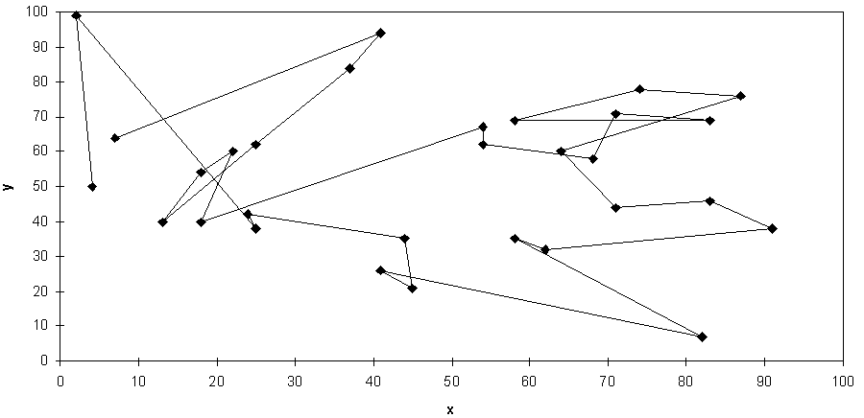
Solution _{k} (Distance = 652)

Slide 44
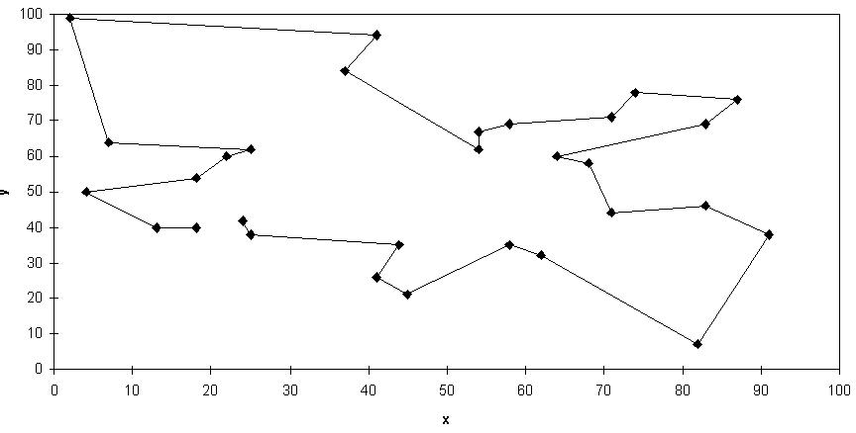
Best Solution (Distance = 420)

Slide 45
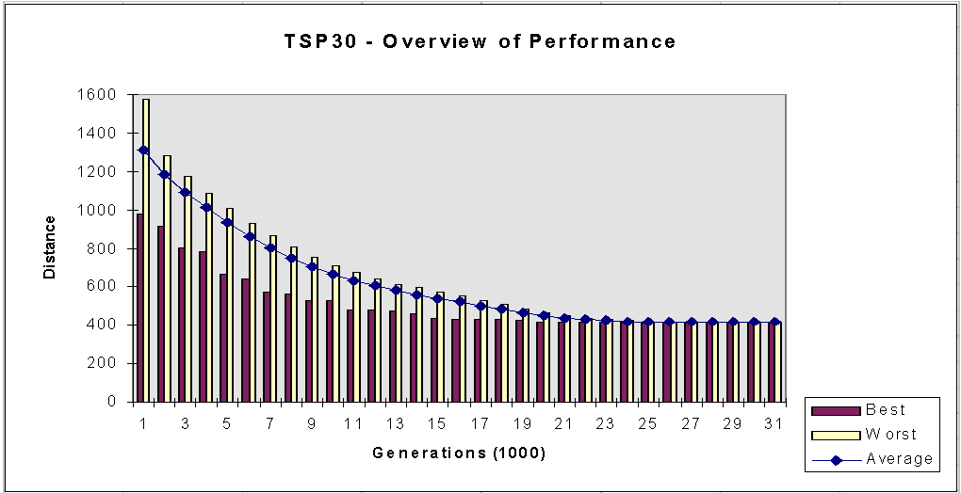
Overview of Performance

Slide 46
Theoretical Analysis of GA (Holland)
Schema: subsets of chromosomes that are similar
The same alleles in certain locations
A given chromosome can be in many schema

Slide 47
Schema - Fitness
Every time we evaluate the fitness of a
chromosome we collect information about average fitness to each of the schemata
Theoretically: population can contain
(M*2^{n}) schemata
In practice: overlap

Slide 48
GA – Inherently Parallel
Many schemata are evaluated in parallel
Under reasonable assumptions: O(M³) schemata
When using the genetic operators, the schemata present in the population will increase or decrease in numbers according to their relative fitness
Schema theorem

Slide 49
Length and Order for Schemata
Length: distance between first and last defined position
Order: the number of defined positions
Example:
  Length: 2
  Order: 2

Slide 50
Fitness Ratio
The relation between the average fitness of a schema and the average fitness of the population
F(S) is the fitness of schema S
F(t) is the average fitness of the population at time t
Let f(S,t) be the fitness ratio for schema S at time t
_

Slide 51

Schema Theorem (1)
In a GA with standard reproduction plan where the probabilities for a 1-point crossover and a mutation are P_{c} og P_{m}, respectively, and schema S with order k(S) and length l(S) has a fitness-ratio f(S,t) in generation t, then the expected number of copies of schema S in generation t+1 is limited by:

Slide 52
Schema Theorem (2)
The theorem states that short, low-order, above average schemata receive exponentially increasing trials in subsequent generations of a GA
  Such schemata are called building blocks
This is the basis of the Building Block Hypothesis:
  Combining short, low-order, above average schemata yields high order schemata that also demonstrate above average fitnesses
  This is the fundamental theorem of GAs, showing how GAs explore similarities as a basis for the search procedure

Slide 53
Later Development of Theory
Schema theorems for
  Uniform choice of parents in a crossover
  Choice of both parents based on fitness
Exact expressions in the schema theorem
Analysis by using Walsh-functions (from signal analysis)
Generalization of schema
  design of operators

Slide 54
GA - Extensions and Modifications
Many possibilities for variations
A lot of literature, chaotic
Unclear terminology
Modifications regarding:
  Population
  Encoding
  Operators
  Hybridization, parallellization

Slide 55
GA: Population Size
Small populations: undercoverage
Large population: computationally demanding
Optimal size increases exponentielly with the string-length in binary encodings
A size of 30 can often work
  OK with 10-100
Between N and 2N (Alander)

Slide 56
GA: Initial Population
Usually: random strings
Alternative: seed with good solutions
  faster convergence
  premature convergence
Sophisticated statistical methods
  Latin hypercubes
Often problems with infeasibility

Slide 57
GA: Population Updates
Generation gap
  Replace the whole population each iteration
Steady state
  Add and remove one individual each generation
  Only use part of the population for reproduction
  The offspring can replace
    Parents
    Worst member of population
    Randomly selected individuals (doubtful if this works better)
Avoid duplicates
Uncertain if the best solution so far will survive
Elitism – e.g. have a small set of ”queens”
Selectiv death

Slide 58
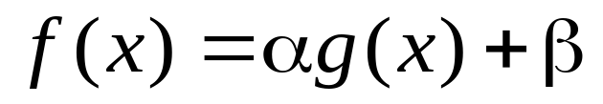
GA: Fitness
The objective function value is rarely suitable
Naïve goal gives convergence to identical individuals
  Premature convergence
Scaling
  Limited competition in early generations
  Increase competition over time

Slide 59
GA: Fitness/Selection
Use ranking instead of objective function value
Tournament selection
  Random choice of groups
  The best in the group advances to reproduction

Slide 60
GA: Operators
Mutation – upholds diversity
  Choice of mutation rate not critical
Crossover – often effective
  Late in the search: crossover has smaller effect
  Selective choice of crossover point
N-point crossover
  2-points has given better performance
  8-point crossover has given best results

Slide 61
GA: Generalized Crossover
Bit-string specifies which genes to use
Parent 1
Mask
Parent 2
Child

Slide 62
GA: Inversion

Slide 63
GA: Hybridization and Parallelization
GAs strengths and weaknesses:
  Domain independence
Hybridization
  Seed good individuals in the initial population
  Combine with other Metaheuristics to improve some solutions
Parallelization
  Fitness-evaluation
  Sub-populations
  The Island Model

Slide 64
Issues for GA Practitioners
Basic implementation issues:
  Representation
  Population size, mutation rate, ...
  Selection, deletion policies
  Crossover, mutation operators
Termination Criteria
Performance, scalability
Solution is only as good as the evaluation function (often hardest part)

Slide 65
Benefits of Genetic Algorithms
Concept is easy to understand
Modular, separate from application
Supports multi-objective optimization
Good for “noisy” environments
Always an answer; answer gets better with time
Inherently parallel; easily distributed

Slide 66
Benefits of Genetic Algorithms (cont.)
Many ways to speed up and improve a GA-based application as knowledge about the problem domain is gained
Easy to exploit previous or alternate solutions
Flexible building blocks for hybrid applications
Substantial history and range of use

Slide 67
When to Use a GA
Alternate methods are too slow or overly complicated
Need an exploratory tool to examine new approaches
Problem is similar to one that has already been successfully solved by using a GA
Want to hybridize with an existing method
Benefits of the GA technology meet key problem requirements

Slide 68
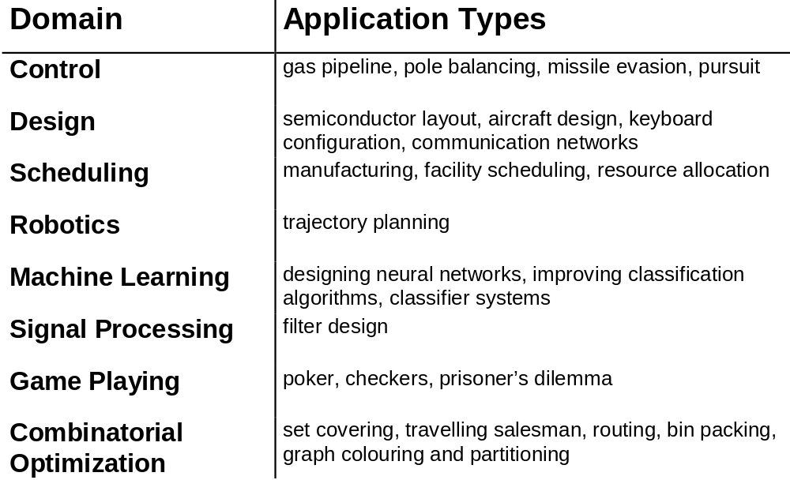
Some GA Application Types

Slide 69
GA: Overview
Important characteristics:
  Population av solutions
  Domaine independence – encoding
  Structure is not exploited
  Inherent parallell – schema, vocabulary
  Robust
  Good mechanisms for intensification
  Lacking in diversification

Slide 70
Genetic Algorithms
Bit-string encoding is inappropriate for many combinatorial problems. In particular, crossover may lead to infeasible or meaningless solutions.
Pure GAs are usually not powerful enough to solve hard combinatorial problems.
Hybrid GAs use some form of local search as mutation operator to overcome this.

Slide 71
Memetic Algorithms (1)
Basically, a Memetic Algorithm is a GA with Local Search as improvement mechanism
  Also known under different names
  An example of hybridization
A meme is a unit of cultural information transferable from one mind to another
  Sounds like gene: the unit carrying inherited information

Slide 72
Memetic Algorithms (2)
The experience is that GAs do not necessarily perform well in some problem domains
Using Local Search in addition to the population mechanisms proves to be an improvement
In a sense this elevates the population search to a search among locally optimal solutions, rather than among any solution in the solution space

Slide 73
Summary of Lecture
Local Search
  Short summary
Genetic Algorithms
  Population based Metaheuristic
  Based on genetics:
    Mutation
    Combination of chromosomes from parents
  Hybridization: Memetic Algorithm

Slide 74
Topics for the next Lecture
Scatter Search (SS)
  For Local Search based Metaheuristics:
    SA based on ideas from nature
    TS based on problem-solving and learning
  For population based Metaheuristics:
    GA based on ideas from nature
    SS based on problem-solving and learning
  Nature works, but usually very slowly
  Being clever is better than emulating nature?

